Slide 1
Solving Connect 4 by Game Tree Search
Member: Haojie Li
Dec 2, 2009

Slide 2
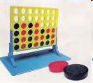
Connect 4 Problem
Connect 4 is a typical 2-player zero-sum discrete finite deterministic game of perfect information
The game tree of connect 4 has 7⁴² nodes at most.
We cannot find guaranteed solution in a reasonable responding time.
It is still a challenge to solve this problem.

Slide 3


Architecture
Development language: Java
Structure
Including:
Game Tree Search with Alpha Beta Pruning
Heuristic evaluation function
Testing terminal state function
  Etc…
GUI Layer
Agent
Object
Connect4GUI
Object
Game
Connect4Listener
Object
Connect4
Object
Notes:
Structure
Connect4GUI
Connect4Listener
The player can play the game GUI layer. It has two objects. The Listener object accepts the input from the player and the GUI object provide the graphic interface to the player.
Connect4
store the state of the current game and make sure two player follow the rule of connect 4.
Agent
Agent is the most important object here.

Slide 4
Heuristic evaluation
Patterns to win a game
A weighted sum of patterns:
h(n) = w1*NumOfPattern1(n)
+ w2*NumOfPattern2(n)
+ w3*NumOfPattern3(n)
Pattern 2
Pattern 3
Pattern 1
Notes:
Obviously, put one more red game piece here, red win this game.
No one want put a game piece here

Slide 5
Efficiency(1)
How to determine the terminal state
Way 1
Way 2

Slide 6
Efficiency(2)
How many states should we save
  Idea 1: Each game tree node has a state
    A successor function need to copy a state seven times to generate seven successor states.
  Idea 2: Only keep one state for whole game tree
    A successor function returns an array of column #.
    No need to copy states. Hence, save time and space.
    Need to undo the change when we navigate from a child node to a parent node in the game tree.

Slide 7
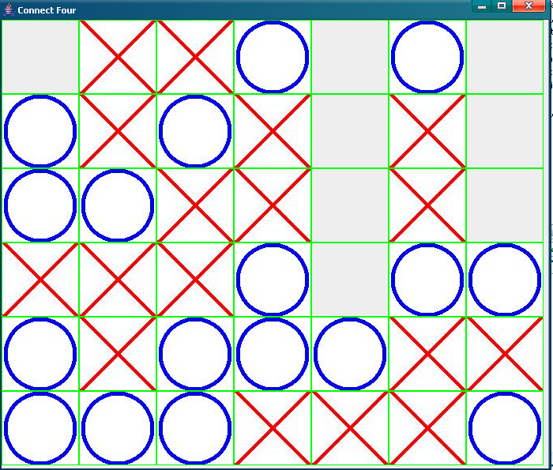
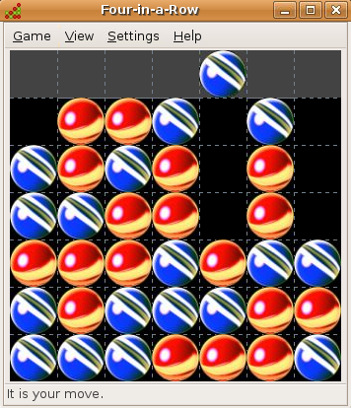
Evaluation and Improvement
Using a more efficient development language, such as C, can improve the performance.
There is still room for improvement in Heuristic evaluation function.
Run my Connect4 against Ubuntu’s Connect4.
VS

